Slide 1

Effective Strategy for verifying DICOM Conformance
Venkateswara Goud
Philips Healthcare - ICAP
Sr.Technical Specialist - Testing Bangalore, India
Co-Authors:
Chitrai Senthamil Selvam – Technical Specialist-Testing
Kishan Harwalkar – Sr.Domain Specialist -Interoperability

Slide 2

Effective DICOM Verification Strategy
Introduction
Challenges
Verification Strategy
Summary
Conclusion

Slide 3
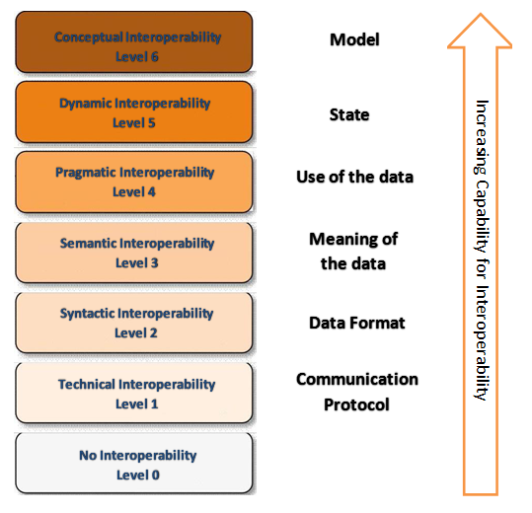
Introduction
Interoperability Levels

Slide 4


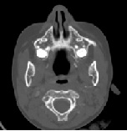
Challenges
Functionality
Interoperability
What is effective
Verification
Strategy ?

Slide 5





Verification Strategy in Nutshell
DICOM Services
Transfer Syntax & Data Conversion
Data Variance
Harmonization & DICOM Data Model
Hazard Scenarios
Media Interoperability
Performance & Stress

Slide 6
DICOM Services
Approach:
Multi Modality & Multivendor Data
Data Variance - VM and VR
Image Consistency
(Patient ID, Patient Name,Series,Images)
Q/R : Mandatory & Optional Keys
Query Levels : Study & Series
Benefits:
DICOM Connectivity Stack Quality
Compliance to DICOM Services
STORE
QUERY/RETRIEVE
VERIFICATION
PRINT
MODALITY WORKLIST
STORAGE COMMITMENT

Slide 7
Transfer Syntax & Data Conversion Verification
Approach:
Multi Modality & Multi Vendor
Transfer Syntaxes Variants Workflow
Scanner →ELE→WS→ILE →PACS →ELE→WS
Benefits:
Attribute Consistency – DICOM
Attribute Consistency – Private
Pixel Data consistency
Compressed & Uncompressed data
movement
Signed / Unsigned Data
Workstation
PACS
ELE
ILE

Slide 8
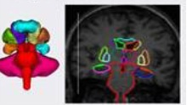
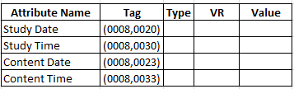
DICOM Data Model & Harmonization
Approach:
Check values against
DICOM & DCS
Check VR,VM values against guidelines
Benefits:
Compliant to DICOM Data Dictionary
Adhering to DCS guidelines
Consistent values/ Harmonized view across applications
Application generated data is compliant to DICOM Standards

Slide 9

Hazard Scenarios
Patient safety aspects
Patient mix-up
Image Generation mechanism
Approach
Data (Pixel) consistency
Signed / Unsigned Data
Image Geometry Checks
Benefits:
Pixel data consistency
Improves the Patient Safety

Slide 10
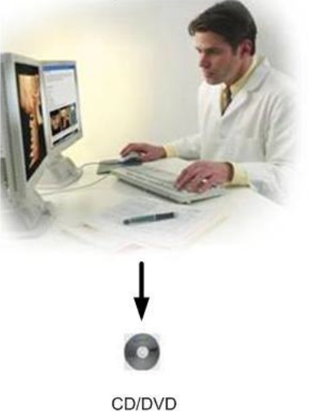
Media Interoperability
Media (CDs/DVDs) Creation/Reading- Standard
Approach:
Different Media Type & Formats
IHE PDI profile tests
Reading of different vendor CDs/DVDs
Benefits:
Media creation/reading - DICOM & IHE compliant

Slide 11

Performance & Stress
Performance - Images Per Second (IPS)
Stress - Size, # Studies, Associations
Resource utilization (Memory & Processor)
Approach:
Images Per Second (IPS)
Memory & Processor Utilization
Patient Size
# Association
Benefits:
Compare Current Vs Released
Benchmarking
Stability & Reliability

Slide 12
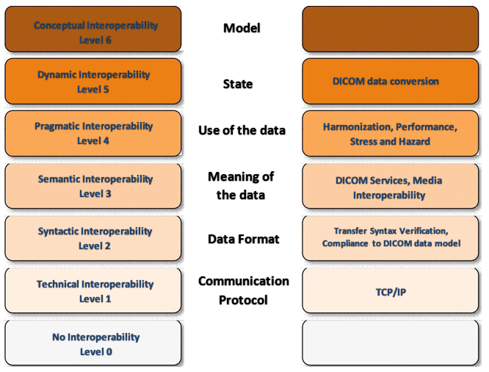
Summary

Slide 13
Conclusion
Media Interop Tests
DICOM Services Tests
Transfer Syntax Tests
Harmonization
Tests
etc..

Slide 14

References
http://dicom.nema.org/
http://www.IHE.net/
http://en.wikipedia.org/wiki/Conceptual_interoperability

Slide 15
Author Contacts
Venkateswara.goud@philips.com
Chitrai.selvam@philips.com
Kishan.Harwalkar@philips.com
Philips Innovation Campus,Bangalore
Thank you for your attention !

